Slide 1
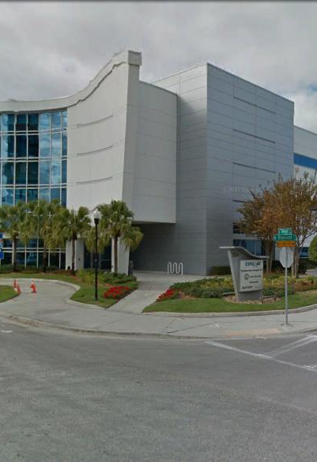
Tampa Hillsborough
Expressway
Authority
Industry Forum
2/8/2019

Slide 2
Introductions
Man Le – THEA Contracts & Procurement Manager
Dave May, PE – THEA Director of Expressway Operations
Bob Frey, AICP – THEA Planning Director
Christina Kopp, AICP – THEA Deputy Planning Director
Sue Chrzan – THEA Director of Public Affairs & Communication
Anna Quinones – THEA Project Manager
Jim Drapp, PE – THEA GEC
Laura Lockwood-Herrscher – THEA GEC
Al Stewart, PE – THEA GEC

Slide 3

Agenda
Project Overview & Schedules
  Whiting Street Ultimate PEIR
  Misc. Planning & Design
  Nebraska/Twiggs Improvements SEIR
  Selmon East PEIR
Procurement
TRC Members
Questions

Slide 4
Whiting Street Ultimate – Whiting Street Extension & Ramps PEIR
Project Overview
Whiting St. from Jefferson St. to North Meridian Ave. including Reconfiguration of Selmon Expressway on-ramps at Jefferson St. and off-ramps at Florida Ave.
PEIR:
PD&E study will be conducted as a PEIR
No state or federal funds
Follow procedures and requirements set forth in FDOT PD&E manual

Slide 5

Whiting Street Ultimate Project
Roles:
Tampa Hillsborough Expressway Authority (THEA) – Owner/Developer/Operator
HNTB – General Engineering Consultant for THEA
Project Objective:
Evaluate operational & design improvements based on traffic needs, costs, impacts
Additional lanes, roadway extension and widening, ramp relocations, widenings and removal and other operational and safety concerns
Coordination:
THEA’s Selmon South Capacity PEIR
SPP/KHA/Stantec

Slide 6
Whiting Street Ultimate Project
Public Involvement
Public Involvement Plan (PIP) in accordance w/PD&E Manual
Advance notification and transmittal letter
Public Meetings:
Minimum one public meeting
Minimum one public hearing
Develop list of stakeholders
Provide website content and update as needed
Legal ads, notices, informational material, news releases, mail outs, court reporting, responses to stakeholders
Meeting coordination; identify/reserve venue, set up, tear down, meeting notes, agendas, presentations, seating, sound, audio/visual equipment, displays
Additional stakeholder/small group meetings as needed

Slide 7
Whiting Street Ultimate
Engineering Analysis
Field review
Survey – LiDAR 3D Model
Existing available data from THEA, FDOT or other agency
Current counts, truck counts, ramp and mainline counts
Turning movement counts at ramp intersections
Traffic methodology statement in accordance with FDOT’s Project Traffic Forecasting Procedure (#525-030-120)
Travel demand forecasting
TBRPM base year 2015
VISSIM
Future years 2026, 2036, 2046 –build alternatives for each year + no build scenario
Traffic:
Geotechnical data

Slide 8
Whiting Street Ultimate Project
Engineering Analysis
Evaluate crash data
Identify safety improvements
Typical sections, design alternatives, access management
Structures (preliminary work by KCA & KHA)
Drainage
Concept plans
Prepare typical section package
Multimodal accommodations
MOT/Phased Construction
Comparative analysis and evaluation matrix
Preferred alternative
ROW and construction estimates
Preliminary Engineering Report

Slide 9
Whiting Street Ultimate Project
Environmental Analysis
Planning consistency
Cultural Resources
Environmental screening tool
Research design and survey methodology
Cultural Resources Assessment Survey (CRAS)
Natural Environment
Noise
Contamination
Prepare PEIR
Sociocultural Resources

Slide 10
Whiting Street Ultimate Project

Slide 11
Whiting Street Ultimate Project

Slide 12
Schedule
Whiting Street Ultimate Project
Procurement: February, 2019 – June 2019
PEIR: July, 2019 – December, 2021
Public Meetings: 2020 & 2021

Slide 13
Miscellaneous Planning & Design
Roles:
Tampa Hillsborough Expressway Authority (THEA) – Owner/Developer/Operator
HNTB – General Engineering Consultant for THEA
Project Objective:
Perform miscellaneous planning, design and CEI assignments
Contract Information:
THEA will select 3 to 5 consultants
Assignments up to $200,000
Design or CEI of Projects with construction value of less than $2,000,000

Slide 14
Schedule
Miscellaneous Planning & Design
Procurement: March, 2019 – July 2019
PIER: July, 2019 – June, 2022
Three year contract w/two one year options

Slide 15
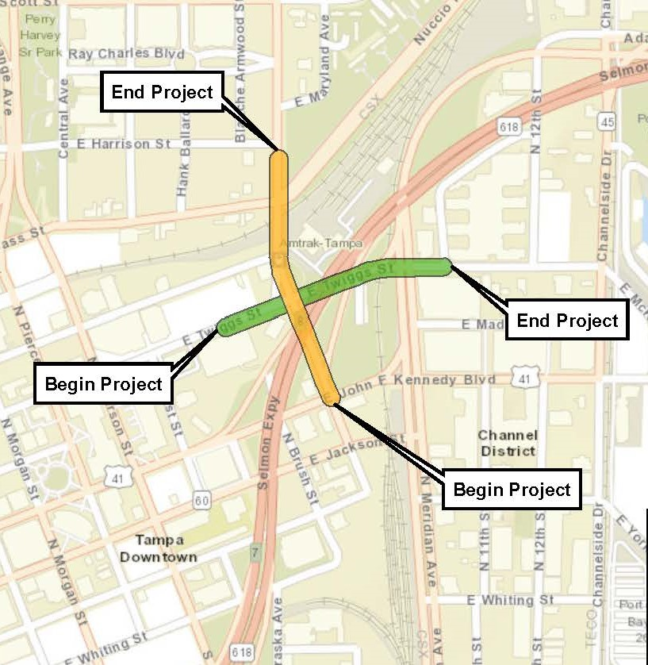
Nebraska SEIR
Project Overview
Nebraska Avenue from South of Twiggs Street to North of the Cass Street/Nuccio Parkway Intersection
SEIR:
PD&E study will be conducted as a SEIR
Follow procedures and requirements set forth in FDOT PD&E manual

Slide 16
Nebraska SEIR Project
Roles:
Tampa Hillsborough Expressway Authority (THEA) –Developer
Florida Department of Transportation (FDOT) – Owner/Operator
City of Tampa – Owner/Operator
HNTB – General Engineering Consultant for THEA
Project Objective:
Evaluate short-term operational capacity improvements along Nebraska Avenue from south of Twiggs Street to north of Cass Street/Nuccio Parkway
Coordination:
THEA’s planned DB project to add an additional westbound lane along Twiggs Street from Meridian Avenue to Nebraska Avenue (Project #O-00918)
City of Tampa, FDOT & CSX

Slide 17
Nebraska SEIR Project
Public Involvement
Public Involvement Plan (PIP) in accordance w/PD&E Manual
Advance notification and transmittal letter
Public Meetings:
Minimum one public meeting
Minimum one public hearing
Develop list of stakeholders
Provide website content and update as needed
Legal ads, notices, informational material, news releases, mail outs, court reporting, responses to stakeholders
Meeting coordination; identify/reserve venue, set up, tear down, meeting notes, agendas, presentations, seating, sound, audio/visual equipment, displays
Additional stakeholder/small group meetings as needed

Slide 18
Nebraska SEIR Project
Engineering Analysis
Field review
Survey/aerial photography – LiDAR 3D Modal (curb to curb)
Geotechnical data
Utilities
Traffic:
Existing available data from, FDOT, City of Tampa, Hillsborough County or other agency
Current counts, truck counts, ramp and mainline counts at toll gantry
Turning movement counts at intersections specified in scope
Traffic methodology statement in accordance with FDOT’s Project Traffic Forecasting Procedure (#525-030-120)
Travel demand forecasting, TBRPM base year 2015
VISSIM
Future years 2026, 2036, 2046-operational build analysis for alternatives

Slide 19
Nebraska SEIR Project
Engineering Analysis
Evaluate crash data
Identify safety improvements
Typical sections, design alternatives, access management
Railroad operations
Drainage
Concept plans
Prepare typical section package
Multimodal accommodations
MOT
Up to three alternatives for Nebraska Avenue
Preferred alternative
ROW and construction estimates
Preliminary Engineering Report

Slide 20
Nebraska SEIR Project
Environmental Analysis
ETDM tool
Sociocultural Resources
Planning consistency
Cultural Resources
Environmental screening tool
Research design and survey methodology
Cultural Resources Assessment Survey (CRAS)
Natural Environment
Noise
Contamination
Prepare SEIR

Slide 21
Schedule
Procurement: August, 2019 – December 2019
SEIR: January, 2020 – December, 2021 or earlier
Public Meetings: 2020 & 2021
Nebraska SEIR Project

Slide 22
East Selmon PEIR Project
Project Overview
Recommended Improvements from ongoing East Selmon Study
PEIR:
PD&E study will be conducted as a PEIR
No state or federal funds
Follow procedures and requirements set forth in FDOT PD&E manual

Slide 23
East Selmon PEIR Project
Roles:
Tampa Hillsborough Expressway Authority (THEA) – Owner/Developer/Operator
HNTB – General Engineering Consultant for THEA
Project Objective:
Evaluate capacity improvements based on traffic needs, costs, impacts
Additional lanes, barrier wall, inside paved shoulders, elevated lanes, additional lanes to inside and outside of existing lanes, dynamic toll pricing and other operational and safety concerns
Coordination:
THEA’s South Selmon Safety Project DB, FDOT, Hillsborough County, City of Tampa & CSX

Slide 24
Schedule
Procurement: August, 2019 – December, 2019
PEIR: January, 2020 – December, 2021
Public Meetings: 2020 & 2021
East Selmon PEIR Project

Slide 25
Procurement
Letter of Interest
Short-list
Presentations/Q&A by Short-listed firms

Slide 26

TRC Members and Technical Advisors
  TRC Members:
    Dave May, PE – THEA
    Bob Frey, AICP – THEA
    Christina Kopp, AICP – THEA
  Technical Advisors:
    Sue Chrzan – THEA
    Jim Drapp, PE – THEA GEC
    Al Stewart, PE – THEA GEC
    Laura Lockwood-Herrscher – THEA GEC
    Julian Gutierrez, PE– THEA GEC

Slide 27
Project Documents
http://www.tampa-xway.com/procurement/#
Once advertised, the cone of silence will be in place for all THEA, FDOT, HNTB, COT, Tierra and OMNI staff.
All questions should be emailed to Man Le, THEA Contracts & Procurement Manager: man.le@tampa-xway.com
Answers will be posted on the THEA website

Slide 28

Questions?

