Slide 1
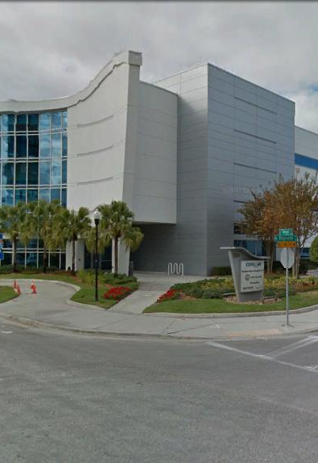
Tampa Hillsborough
Expressway
Authority (THEA)
Janitorial Services
Pre-Bid Conference & Site Visit
1/7/2022
THEA Project No. O-02221

Slide 2
Introductions
Man Le – THEA Contracts & Procurement Manager
Brian Pickard, PE – THEA Director of Operations and Engineering
Judith Villegas, EI – THEA Project Manager
Sally Fischer – THEA Project Manager
Charlene Ponce – THEA Executive Assistant to CEO
Max Artman– THEA Tolls Operations Analyst
Jim Drapp, PE – THEA GEC

Slide 3
Project Roles
Tampa Hillsborough Expressway Authority (THEA)- Owner
  Sally Fischer - THEA Project Manager
HNTB- General Engineering Consultant (GEC) to THEA

Slide 4

Agenda
Project Overview & Objectives
Response Package
Bid Price Proposal
Evaluation Process
Procurement Schedule
SBE
TRC Members & Technical Advisors
Project Documents
Questions

Slide 5
Project Overview & Objectives
Janitorial Services for THEA Transportation Management Center (TMC) & East Toll Plaza Building
  TMC Building

Slide 6
Project Overview & Objectives
Details included in the RFP package for:
  Contractor Personnel Requirements
  Janitorial Equipment and Supplies
  Management and Supervision
Cleaning Schedule as follows:

Slide 7
Project Overview & Objectives

Slide 8
Project Overview & Objectives

Slide 9
Project Overview & Objectives

Slide 10
Project Overview & Objectives
East Toll Plaza Building- Approx. 2800 SF, Four Cleanings/Year

Slide 11
Response Package
The following forms are required by THEA to be submitted in a sealed envelope for the Response Package:
  A- Public Entity Crime
  B- Drug-Free Work Place
  D- Conflict of Interest
  E- SBE Anticipated Participation Form
  F- Questionnaire
The following form shall also be submitted in a separate sealed envelope:
  C- Bid Proposal Form
All forms shall meet the following requirements
  8 ½” x 11” sheets
  Minimum font size ten (10)
  THEA must receive all submittals to Man Le at 1104 East Twiggs Street, Suite 300, Tampa, FL 33602 not later than 2:00 PM EST on Thursday, January 20, 2022

Slide 12
Bid Price Proposal
One (1) hard copy Bid Price Proposal shall be hand delivered in separate, sealed package to THEA
  Evaluation scoring based on combined cost of years 1, 2 & 3

Slide 13
Evaluation Process
Authority receives Response Package and Bid Price Proposal
THEA TRC members review the Response Package based on RFP criteria
THEA TRC members turn in Response Package scores
Bid Price Proposals opened and scores calculated
Total highest score ranked number one

Slide 14
Evaluation Process

Slide 15
Procurement Schedule
Notes:
n

Slide 16
SBE
THEA’s Small Business Enterprise (SBE) Policy requires nondiscrimination on the basis of race, color, national origin, and gender in its employment and contracting practices and encourages the solicitation and utilization of SBE’s. This means that the Authority’s goal is to spend a portion of the highway dollars with Certified SBE’s as prime Design-Build Firms or as subcontractors. Race-neutral means that the Authority believes that the overall goal can be achieved through the normal competitive procurement process. THEA has exceeded 15% SBE participation on its program for the last several years.

Slide 17

TRC Members and Technical Advisors
  TRC Members:
    Sally Fischer – THEA
    Charlene Ponce – THEA
    Max Artman – THEA
  Technical Advisors:
    Brian Pickard, PE – THEA
    Judith Villegas, EI – THEA
    Jim Drapp, PE – THEA GEC
    Terry Opdyke – THEA GEC

Slide 18
Project Documents
http://www.tampa-xway.com/procurement/#
The cone of silence remains in place for all THEA and HNTB staff. The cone of silence begins on date of advertisement and ends upon Board Approval.
All questions should be emailed to Man Le, THEA Contracts & Procurement Manager: man.le@tampa-xway.com
Answers will be posted on the THEA website and Demandstar

Slide 19

All questions should be emailed to Man Le, THEA Contracts & Procurement Manager: man.le@tampa-xway.com

